Slide 1
MATH156-RC1
He Yubin
2025.9.30

Slide 2
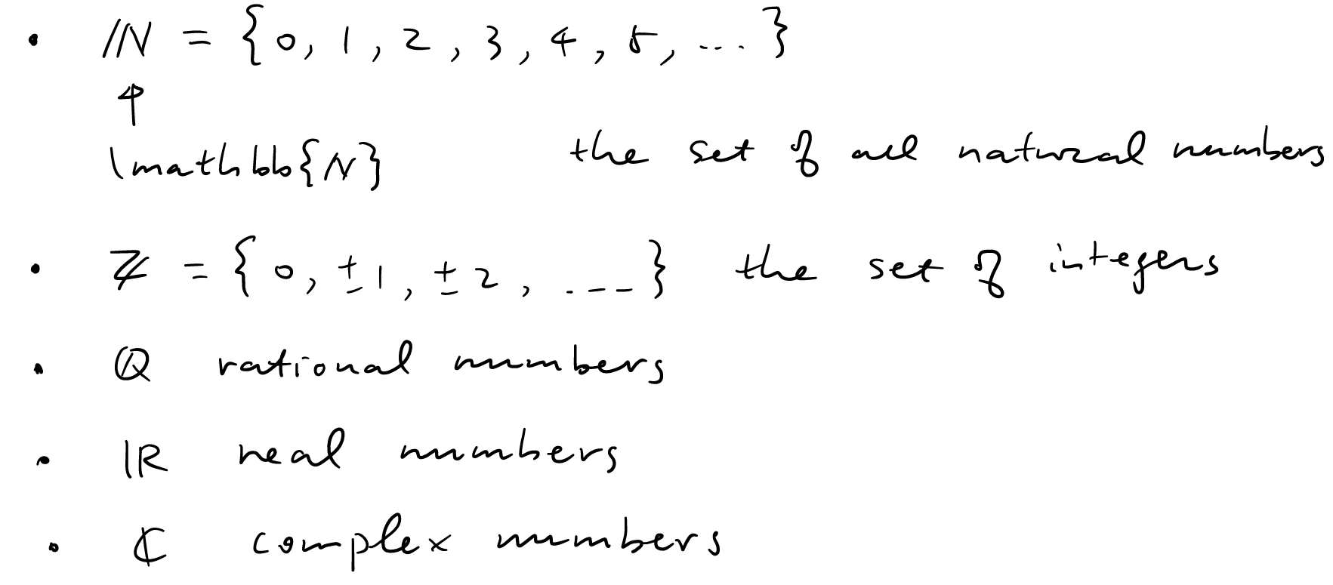
Notation for Sets of Numbers

Slide 3


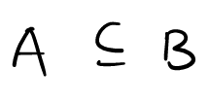

Set
Cardinality:
Set Operations:
Subset:
Proper Subset:

Slide 4
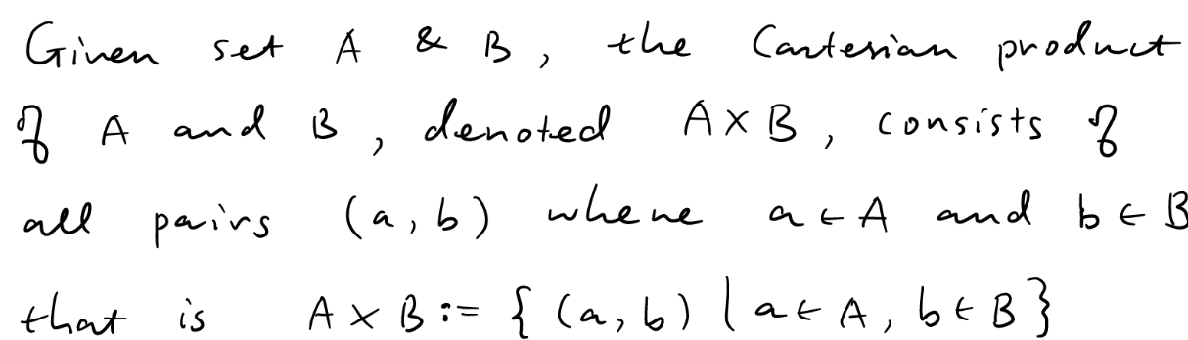
Cartesian Product

Slide 5
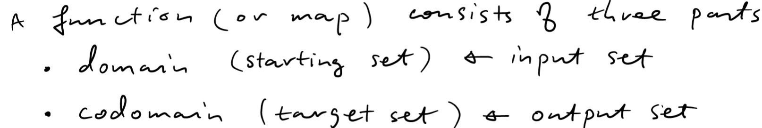
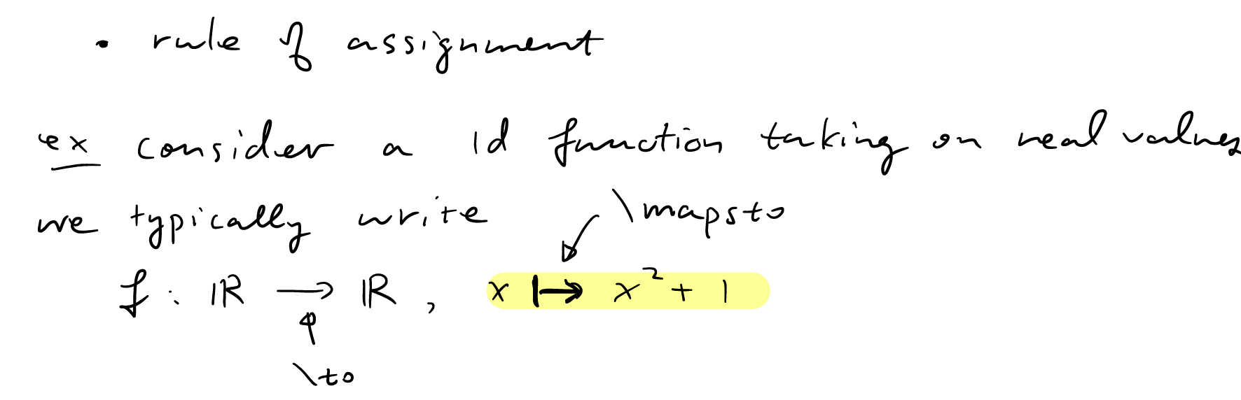
Functions

Slide 6
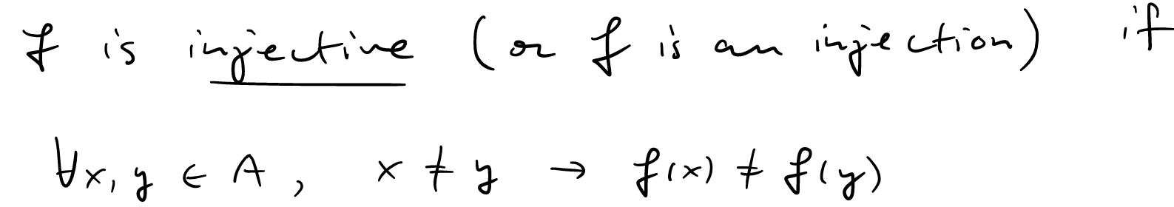
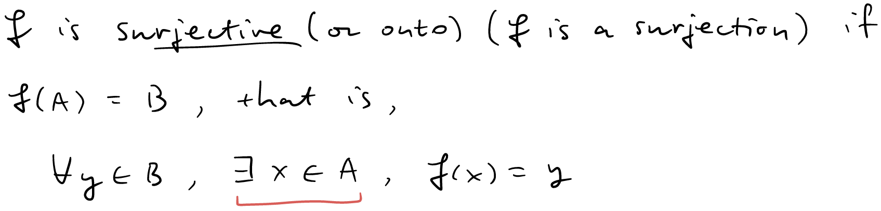
Injection/Surjection/Bijection

Slide 7
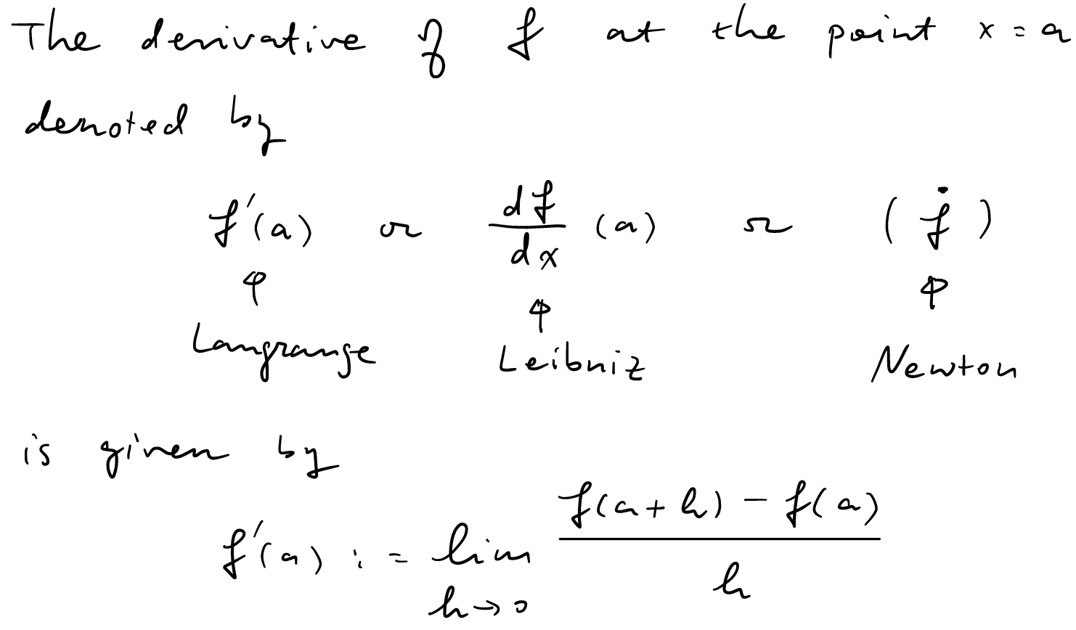
Derivative

Slide 8
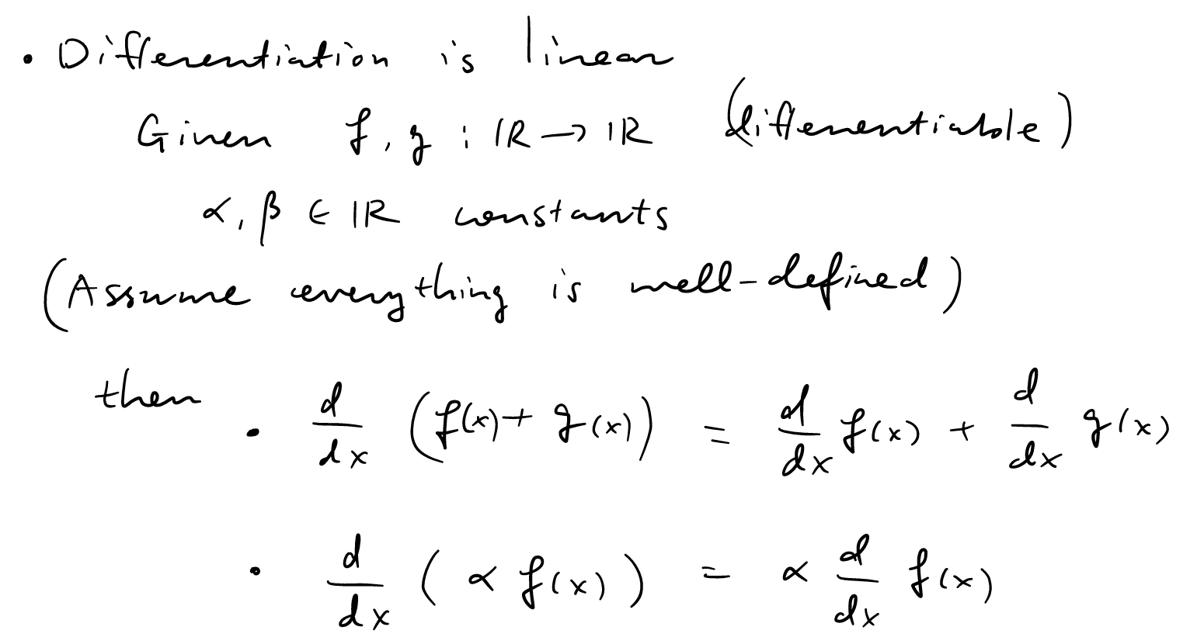

Slide 9
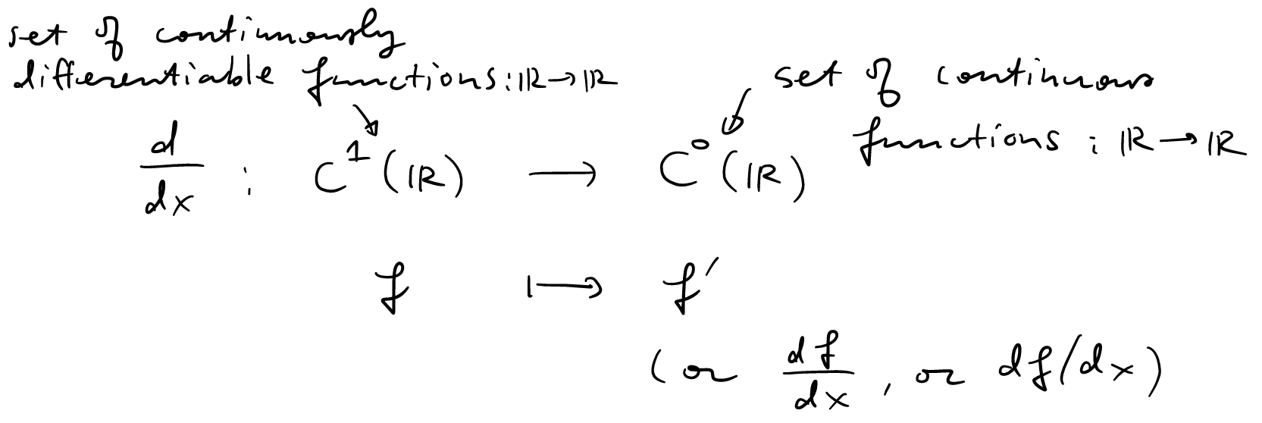
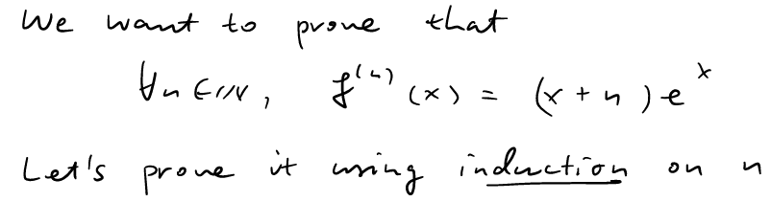
Two Important notations

Slide 10
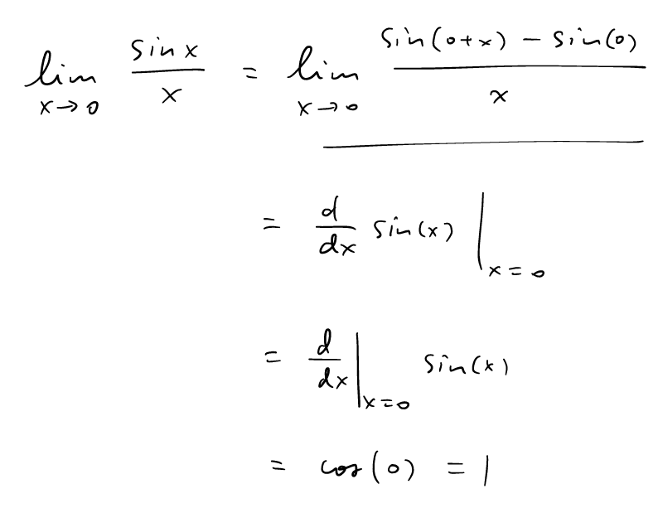
One method for solving limits

Slide 11
References
[1] Cai, Runze. 156-fa250918.pdf. 2025.
[2] Cai, Runze. 156-fa250919.pdf. 2025.
[3] Cai, Runze. 156-fa250923.pdf. 2025.
[4] Cai, Runze. 156-fa250925.pdf. 2025.

